Slide 1
Chapter 3
  DATA VISUALIZATION

Slide 2
DATA VISUALIZATION
  Data visualization is the graphical representation of information and data.
  There are two primary uses for data visualization:
  To explore data
  To communicate data

Slide 3
Univariate Visualization
  Visual exploration starts with investigating one attribute at a time using univariate charts.
  The techniques discussed in this section give an idea of how the attribute values are distributed and the shape of the distribution.
    Histogram
    Bar Graph
    Box Plot

Slide 4
Histogram
  A histogram is one of the most basic visualization techniques to understand the frequency of the occurrence of values.
  A histogram is the graphical representation of quantitative data.
  It shows the distribution of the data by plotting the frequency of occurrence in a range.
  In a histogram, the attribute under inquiry is shown on the horizontal axis and the frequency of occurrence is on the vertical axis.
  Histograms are used to find the central location, range, and shape of distribution.

Slide 5
Histogram
  It might be normal distribution, left skewed, right skewed, uniform or any other.
  Understanding the distribution can help in dealing with missing values such as,
  If left-skewed or right-skewed, then use median as median is not affected by extreme values
  If normal distribution, then use mean.

Slide 6
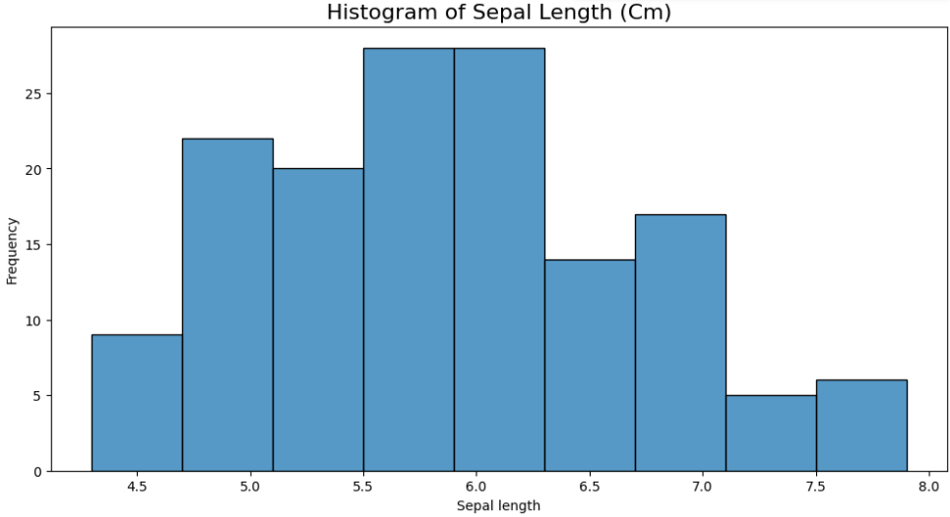
Histogram
The values with longer plots signify that more values are concentrated there.
Histograms help in understanding the frequency distribution of the overall data points for that feature.

Slide 7
Shape of Histogram ?
Bimodal
Uniform

Slide 8
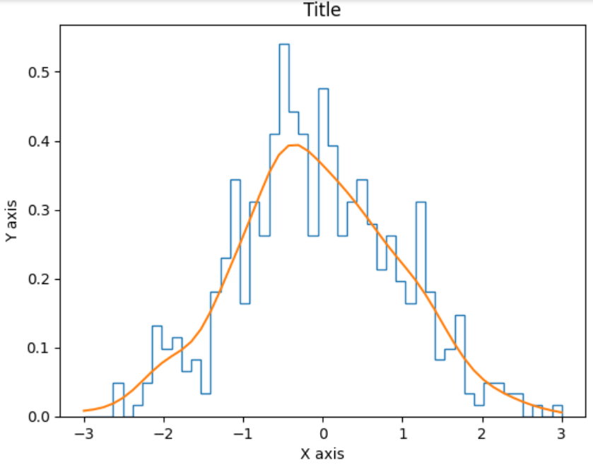
LINE HISTOGRAMS (MODIFICATION TO HISTOGRAMS)
Normal Histogram is a bell-shaped histogram with most of the frequency counts focused in the middle with diminishing tails.
Line with orange color passing through histogram represents Gaussian distribution for data points.

Slide 9
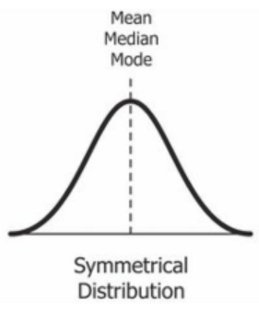
Skewness in Data
the normal distribution is the probability distribution without any skewness.
You can look at the image below, which shows symmetrical distribution that’s a normal distribution.
you can see that it is symmetrical on both sides of the dashed line.

Slide 10
Skewness in Data
There are two types of skewness.
Positive skewness
Negative skewness

Slide 11
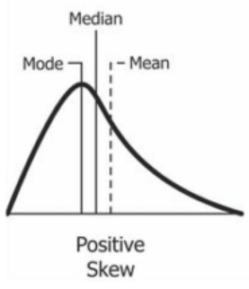
Positive Skewness
A histogram in which most of the data falls to the right of the graph's peak is known as a right-skewed histogram.
It is also known as a positively skewed histogram.

Slide 12
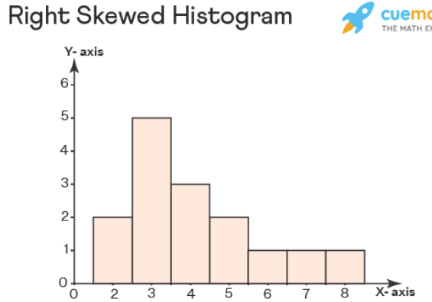
Positive Skewness
A right-skewed histogram or a positively skewed distribution is a type of histogram that is not symmetrical and in which the peak of the graph lies to the left of the middle value or the median. Let us draw a histogram showing the given data: 2, 3, 3, 4, 3, 8, 3, 3, 2, 5, 7, 4, 5, 4, 6.
When we draw a histogram showing the above data, we found that it is skewed to the right.

Slide 13
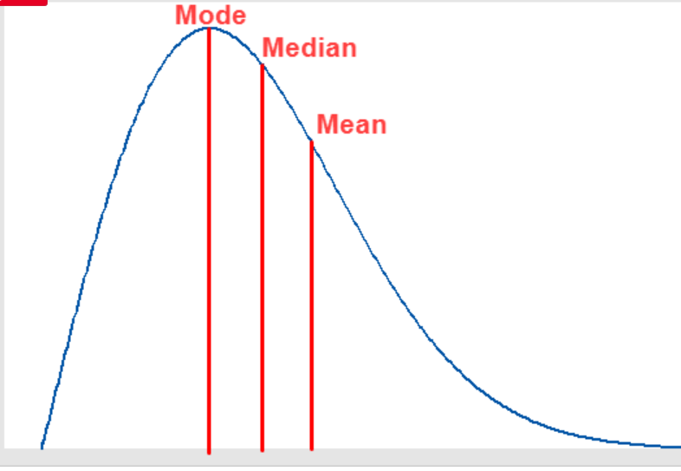
Right Skewed or Positive Skewed
In a histogram skewed to the right, the value of mode is to the left of the value of the median as in a right-skewed histogram the peak of the graph (mode) occurs to the left of the center of the graph (median).
most of the values or observations fall on the right side of the graph, therefore the value of mean comes to the right of the center or the median of the right-skewed histogram distribution.
Therefore, the relation between the mean, median, and mode of a right-skewed histogram is given as Mean > Median > Mode.

Slide 14
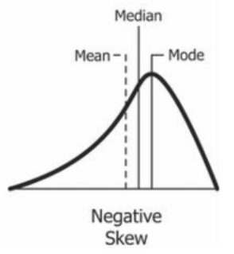
Negative Skewness
A negatively skewed distribution is the left-skewed distribution with the long tail on its left side.
You can also see in the above figure that the measure of central tendencies is mean < median < mode.

Slide 15
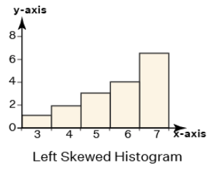
Left skewed or Negative Skewed

Slide 16
Bar Graphs
  Bar charts are best suited for the visualization of categorical data because they allow you to easily see the difference between feature values by measuring the size(length) of the bars.

Slide 17
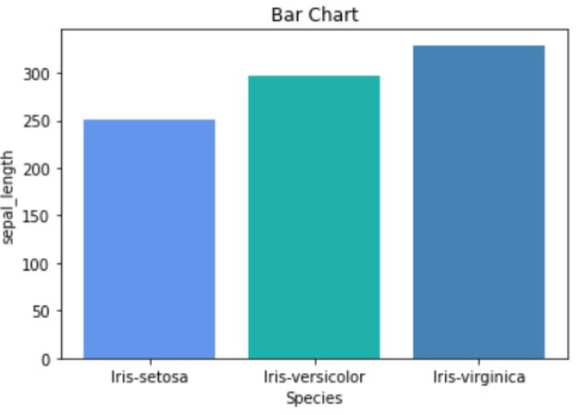
Bar Graphs
With the above image, we can clearly see the difference in the sum of sepal_length for each species of a leaf.

Slide 18
Box Plots
  The simplest way to detect outliers is by drawing box plots.
  Box plots, also known as box and whisker plots, are an easy way to observe the distribution of the data you’re analyzing.
  The box demonstrates the central 50% of the data, with a line in the middle that shows the median value.
  The lines extending from the box capture the range of the remaining data.
  Any data point that falls outside the lines indicates an outlier.

Slide 19
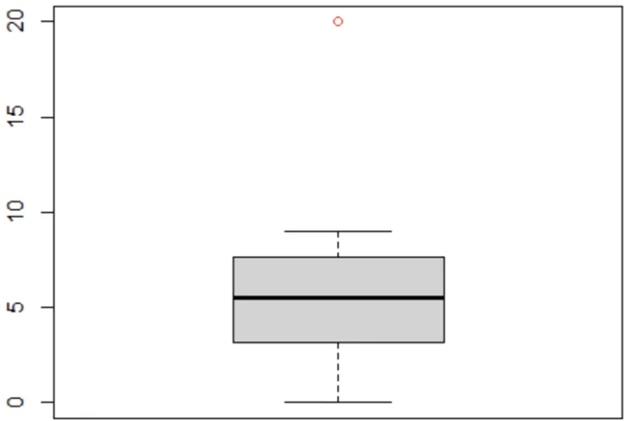
Box Plots
  In the plot below, we can see that the red dot sitting outside of the boxplot is an outlier:

